Slide 1

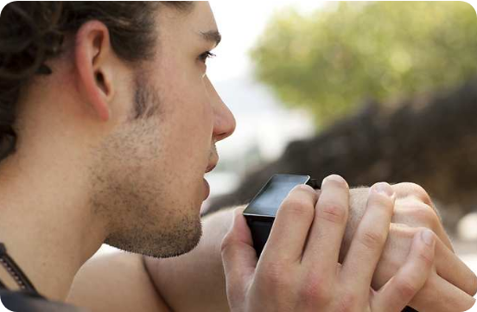
01 / 10
AI IN EVERYDAY LIFE • 26IT054
EVERYDAY TECH, REIMAGINED
AI in Everyday Life
How Artificial Intelligence Makes Our Daily Activities Smarter
A first-year college AI practical
AI PRACTICAL • 26IT054
Voice assistant
Personal picks
Smart route

Slide 2
01 / THE BASICS
02 / 10
What is Artificial Intelligence?
AI helps machines perform tasks that usually need human-like abilities.
In simple words: Artificial Intelligence (AI) is technology that helps computers recognize patterns, understand language, make predictions, and offer recommendations.
01
02
03
Learn from data
Recognize patterns
Predict or recommend
Find useful patterns in examples.
Notice similarities and signals.
Suggest what may be useful next.
INPUT DATA → AI FINDS PATTERNS → USEFUL OUTPUT
ARTIFICIAL INTELLIGENCE • PRACTICAL

Slide 3

02 / ALL AROUND US
03 / 10
AI is closer than you think
Many everyday apps use AI quietly in the background.
Voice assistants
Respond to spoken requests and questions.
Navigation apps
Estimate travel time and suggest routes.
Shopping picks
Recommend products based on activity.
Spam detection
Flag messages that may be unwanted.
AI chatbots
Help explain topics or answer queries.
AI often works behind the scenes to make familiar tools more useful.
ARTIFICIAL INTELLIGENCE • PRACTICAL

Slide 4


03 / IN YOUR POCKET
04 / 10
AI in smartphones
Your phone can recognize, enhance, predict, and respond.
01
02
Face recognition
Speech & voice typing
Helps unlock a device securely.
Turns spoken words into text.
03
04
Camera enhancement
Predictive text
Detects scenes and improves images.
Suggests words as you type.
SMARTPHONE AI • Recognize • Enhance • Suggest
ARTIFICIAL INTELLIGENCE • PRACTICAL

Slide 5

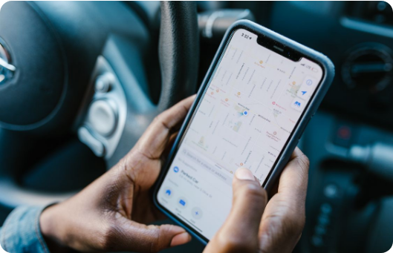
04 / DISCOVER & EXPLORE
05 / 10
AI in navigation and entertainment
AI predicts what may help you next—based on available signals.
01 / GET THERE
A smarter route
Navigation apps use available traffic and map information to estimate travel times and suggest routes.
Music
Video
Shopping
Find songs that fit your listening patterns.
Suggest content based on viewing activity.
Recommend products from browsing patterns.
Recommendations are predictions—not guarantees.
ARTIFICIAL INTELLIGENCE • PRACTICAL

Slide 6


05 / LEARN & CONNECT
06 / 10
AI in education and communication
AI can support learning, but it should not replace your own thinking.
Ask questions
Improve writing
Chatbots can explain difficult ideas.
Grammar tools flag spelling and wording issues.
Translate
Plan study time
Language tools help people communicate.
Suggestions can help organize a study routine.
Personalize practice
Learning tools may recommend suitable exercises.
AI Study buddy
Student: “Can you explain photosynthesis simply?”
AI: “Plants use sunlight to make food from water and carbon dioxide.”
Then check the explanation against reliable notes or a textbook.
ARTIFICIAL INTELLIGENCE • PRACTICAL

Slide 7
06 / THE UPSIDE
07 / 10
Benefits of AI in everyday life
Used thoughtfully, AI can make everyday tasks easier.
01
Saves time
Automates or speeds up some routine tasks.
02
Personalizes services
Tailors suggestions to activity and preferences.
03
Supports accessibility
Speech, captions, and translation can aid access.
04
Finds patterns
Processes large amounts of information quickly.
05
Informs decisions
Provides useful options to consider.
AI supports people best when its suggestions are considered—not followed blindly.
ARTIFICIAL INTELLIGENCE • PRACTICAL

Slide 8
07 / STAY IN CONTROL
08 / 10
Limitations & responsible AI use
AI is useful, but its output needs human judgment.
Know the limitations
Use AI responsibly
• It can give incorrect information.
1. Protect: Keep sensitive personal information private.
• Personal data may create privacy risks.
2. Verify: Check important facts with reliable sources.
• Results can reflect bias in data or design.
3. Think: Question answers that seem doubtful.
• Overuse may weaken independent thinking.
4. Balance: Use AI as support, not a substitute for effort.
Important decisions need human review.
A good rule: pause, check, then decide.
RESPONSIBLE AI USE
ARTIFICIAL INTELLIGENCE • PRACTICAL

Slide 9

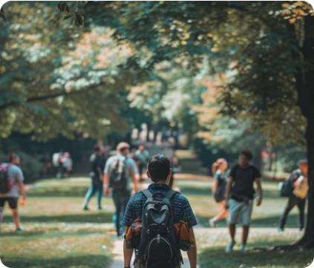
08 / ONE STUDENT, THREE MOMENTS
09 / 10
A day in the life of AI
AI offers suggestions; the student remains in charge.
MORNING • Travel to college
AI DOES: AI suggests a route using available traffic information.
YOU DECIDE: Student decides when to leave and which route to take.
AFTERNOON • Study a tough topic
AI DOES: A chatbot explains a concept in simpler language.
YOU DECIDE: Student checks the explanation against reliable materials.
EVENING • Relax with media
AI DOES: A platform recommends music or videos from past activity.
YOU DECIDE: Student chooses what to watch or listen to.
STUDENT-CENTRIC AI WORKFLOW
ARTIFICIAL INTELLIGENCE • PRACTICAL

Slide 10
THE TAKEAWAY
10 / 10
AI makes life smarter—not perfect.
Artificial Intelligence is already part of everyday life. It can make tasks more convenient, support learning, and provide useful recommendations. Use it responsibly and verify important information.
“AI is a helpful tool, but human judgment still matters.”
Thank You
Stay curious. Think critically. Use AI wisely.
AI PRACTICAL • 26IT054
END OF PRESENTATION

